Slide 1
Sexuality and Gender
Chapter 10

Slide 2
Chapter 4 Learning Objective Menu
LO 10.1 Physical differences between males and females
LO 10.2 Gender
LO 10.3 Influence of biology and learning on gender development
LO 10.4 Theories on gender role learning
LO 10.5 Gender stereotyping
LO 10.6 Androgyny
LO 10.7 Gender differences in thinking, social behavior, and personality
LO 10.8 Controversy of treatment of intersexed infants
LO 10.9 Bodies of men and women during sexual intercourse
LO 10.10 Masters and Johnson and the human sexual response
LO 10.11 Kinsey’s study of human sexual behavior
LO 10.12 Findings of the Janus Report
LO 10.13 Sexual orientations and how they develop
LO 10.14 Sexual dysfunctions caused by physical problems or stress
LO 10.15 Sexual dysfunctions called paraphilias
LO 10.16 Sexually transmitted diseases
LO 10.17 Protect against and prevent STDs

Slide 3
Male and Female Physical Differences
LO 10.1 Physical differences between males and females
Primary sex characteristics – sexual organs present at birth and directly involved in human reproduction.
Vagina - the tube that leads from the outside of a female’s body to the opening of the womb.
Uterus - the womb in which the baby grows during pregnancy.
Ovaries- the female sexual glands.
Testes (testicles) - the male sex glands.
Scrotum - external sack that holds the testes.
Prostate gland - gland that secretes most of the fluid holding the male sex cells or sperm.
Menu

Slide 4
Male and Female Physical Differences
LO 10.1 Physical differences between males and females
Primary sex characteristics – sexual organs present at birth and directly involved in human reproduction.
  Female Primary Sex Characteristics
    Vagina - the tube that leads from the outside of a female’s body to the opening of the womb.
    Uterus - the womb in which the baby grows during pregnancy.
    Ovaries- the female sexual glands.
Menu

Slide 5
Male and Female Physical Differences
LO 10.1 Physical differences between males and females
  Male Primary Sex Characteristics
    Penis – male sex organ.
    Testes (testicles) - the male sex glands.
    Scrotum - external sack that holds the testes.
    Prostate gland - gland that secretes most of the fluid holding the male sex cells or sperm.
Menu

Slide 6
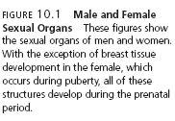
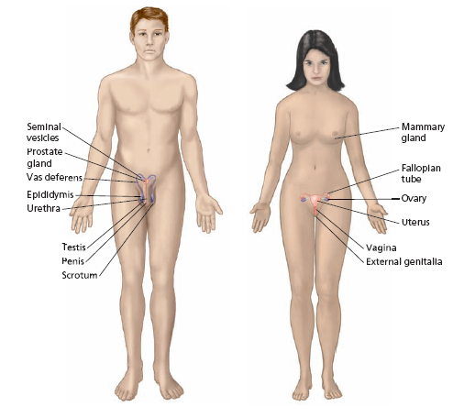
LO 10.1 Physical differences between males and females
Menu

Slide 7
Male and Female Physical Differences
LO 10.1 Physical differences between males and females
Secondary sex characteristics - sexual organs and traits that develop at puberty and are indirectly involved in human reproduction.
  Female Secondary Sex Characteristics
    Growth spurt
    Onset of the menstrual cycle - monthly shedding of the blood and tissue that line the uterus in preparation for pregnancy when conception does not occur
    Breast development
      Mammary glands - glands within the breast tissue that produce milk when a woman gives birth to an infant.
    Widening hips
    Pubic hair
    Fat deposits
    Further growth and development of the uterus, vagina, and ovaries
Menu

Slide 8
Male and Female Physical Differences
LO 10.1 Physical differences between males and females
  Male Secondary Sex Characteristics
    Enlarged larynx (Adam’s apple)
    Deepening voice
    Facial and chest hair
    Pubic hair
    Coarser skin texture
    Large increase in height
Estrogens - female sex hormones.
Androgens - male sex hormones.
Menu

Slide 9

Gender
LO 10.2 Gender
Gender- the psychological aspects of being male or female.
Gender roles - the culture’s expectations for masculine or feminine behavior, including attitudes, actions, and personality traits associated with being male or female in that culture.
Gender typing - the process of acquiring gender role characteristics.
Gender identity - the individual’s sense of being male or female.
Menu

Slide 10
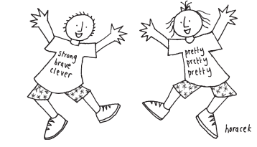
Biology and Learning Influences on Gender
LO 10.3 Influence of biology and learning on gender development
Biological influences - hormones and chromosomes
Environmental influences - parenting, surroundings, and culture on the formation of gender identity.
Menu

Slide 11
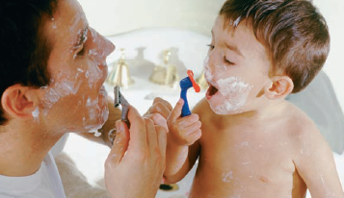
Gender Roles
LO 10.4 Theories on gender role learning
Social learning theory - gender identity is formed through reinforcement of appropriate gender behavior as well as imitation of gender models.
Gender schema theory - theory of gender identity acquisition in which a child develops a mental pattern, or schema, for being male or female and then organizes observed and learned behavior around that schema.
Menu

Slide 12
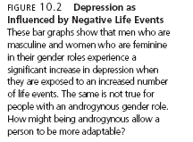
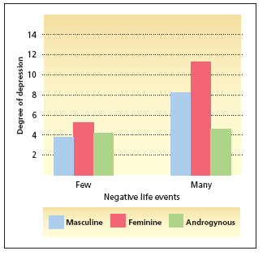
LO 10.4 Theories on gender role learning
Menu

Slide 13
Gender Stereotyping
LO 10.5 Gender stereotyping
Stereotype - a concept held about a person or group of people that is based on superficial, irrelevant characteristics.
Gender stereotype - a concept held about a person or group of people that is based on being male or female.
Sexism - prejudice about males and/or females leading to unequal treatment.
Benevolent sexism - acceptance of positive stereotypes of males and females that leads to unequal treatment.
Menu

Slide 14
Androgyny
LO 10.6 Androgyny
Androgyny - characteristic of possessing the most positive personality characteristics of males and females regardless of actual sex.
Menu

Slide 15
Other Male and Female Differences
LO 10.7 Gender differences in thinking, social behavior, and personality
Cognitive differences - male advantage in mathematical and spatial skills and a female superiority in verbal skills (decreasing differences).
Emotional expression - males tend to talk with each other in a “report” style, whereas females tend to talk to each other in a “relate” style.
Menu

Slide 16

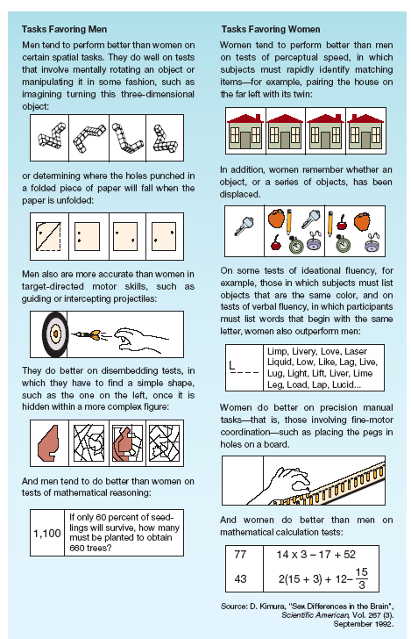
LO 10.7 Gender differences in thinking, social behavior, and personality
Menu

Slide 17
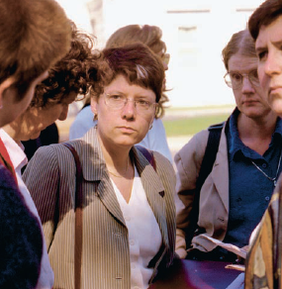
Intersexed Infants
LO 10.8 Controversy of treatment of intersexed infants
Hermaphroditism - the condition of possessing both male and female sexual organs.
  Intersex - alternate term for hermaphroditism.
Intersexed, intersexual - a person who possesses ambiguous sexual organs, making it difficult to determine actual sex from a visual inspection at birth.
Menu

Slide 18
Stages of Human Sexual Response
LO 10.9 Bodies of men and women during sexual intercourse
Excitement – beginning of sexual arousal.
Plateau – physical changes beginning in first stage continue.
Orgasm - a series of rhythmic contractions of the muscles of the vaginal walls or the penis, also the third and shortest phase of sexual response.
  Seminal fluid - fluid released from the penis at orgasm that contains the sperm.
Menu

Slide 19
Stages of Human Sexual Response
LO 10.9 Bodies of men and women during sexual intercourse
Resolution - the final phase of the sexual response in which the body is returned to a normal state.
  Refractory period - time period in males just after orgasm in which the male cannot become aroused or achieve erection.
Menu

Slide 20
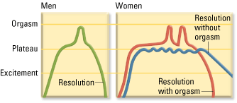
LO 10.9 Bodies of men and women during sexual intercourse
Menu

Slide 21
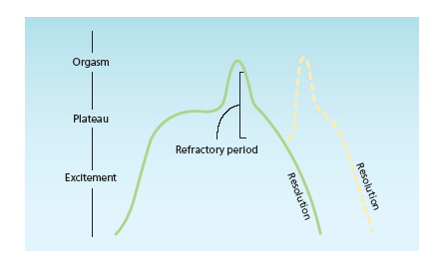
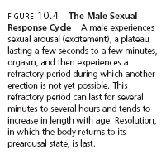
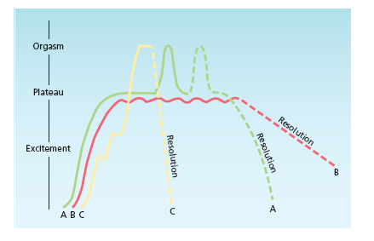
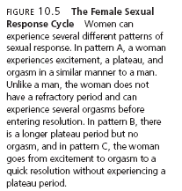
LO 10.9 Bodies of men and women during sexual intercourse
Menu

Slide 22

Masters and Johnson Study
LO 10.10 Masters and Johnson and the human sexual response
Used volunteers, some of whom were prostitutes, and both observed and measured their physiological responses during all phases of sexual intercourse.
Menu

Slide 23
Kinsey Studies
LO 10.11 Kinsey’s study of human sexual behavior
Series of sexual behavior surveys in the late 1940s and early 1950s
Revealed some highly controversial findings about the kinds of sexual behavior common among people in the United States, including:
  Homosexuality
  Premarital sex
  Extramarital sex
Menu

Slide 24

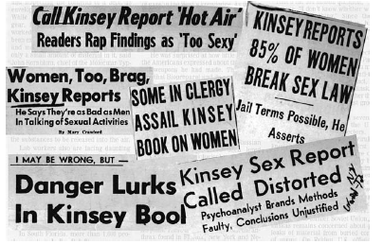
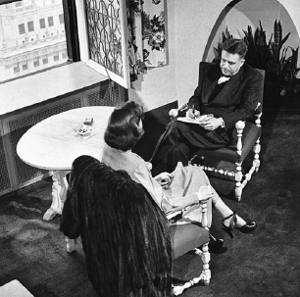
LO 10.11 Kinsey’s study of human sexual behavior
Menu

Slide 25
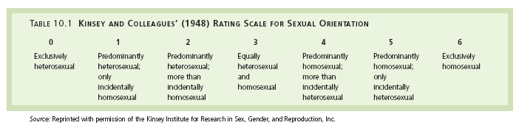
LO 10.11 Kinsey’s study of human sexual behavior
Menu

Slide 26
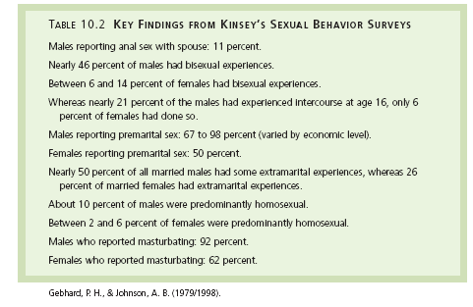
LO 10.11 Kinsey’s study of human sexual behavior
Menu

Slide 27
Janus Report
LO 10.12 Findings of the Janus Report
Large-scale survey of sexual behavior in the United States in 1990s.
Did not differ widely from those of Kinsey but looked at many more types of sexual behavior and factors related to sexual behavior, including:
  Sexual deviance - behavior that is unacceptable according to societal norms and expectations.
Menu

Slide 28
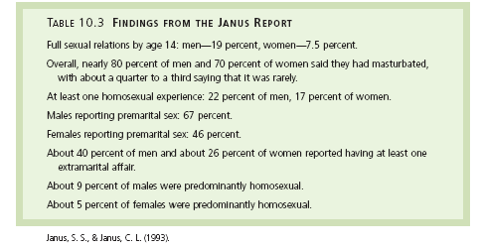
LO 10.12 Findings of the Janus Report
Menu

Slide 29

Sexual Orientation
LO 10.13 Sexual orientations and how they develop
Sexual orientation - a person’s sexual attraction preference for members of a particular sex.
Heterosexual - person attracted to the opposite sex.
Homosexual - person attracted to the same sex.
Bisexual - person attracted to both men and women.
Menu

Slide 30
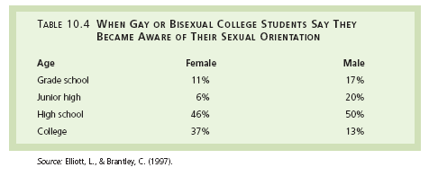
LO 10.13 Sexual orientations and how they develop
Menu

Slide 31
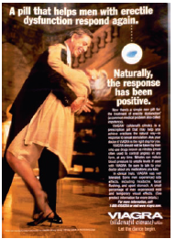
Sexual Dysfunction
LO 10.14 Sexual dysfunctions causes by physical problems or stress
Sexual dysfunction - a problem in sexual functioning.
Organic or stress-induced dysfunction - sexual problem caused by physical disorder or psychological stress.
  Hypoactive sexual desire, sexual aversion, female sexual arousal disorder, male erectile disorder, male orgasmic disorder, female orgasmic disorder, premature ejaculation, vaginismus, and dyspareunia.
Menu

Slide 32
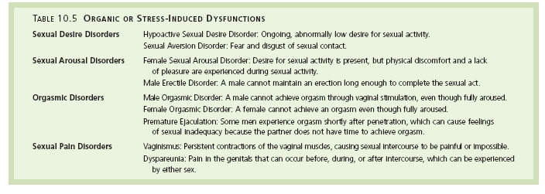
LO 10.14 Sexual dysfunctions causes by physical problems or stress
Menu

Slide 33
Paraphilias
LO 10.15 Sexual dysfunctions called paraphilias
Paraphilia - a sexual disorder in which the person’s preferred method of sexual arousal and fulfillment is through sexual behavior that is unusual or socially unacceptable.
  Pedophilia - deriving sexual arousal and pleasure from touching or having sexual relations with prepubescent (nonsexually mature) children or fantasizing about such contact.
    Pedophile - a person who has recurring sexual thoughts, fantasies, or engages in sexual actions toward prepubescent (nonsexually mature) children.
Menu

Slide 34
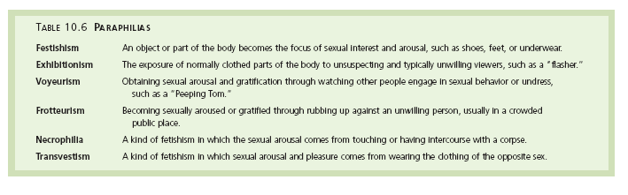
Other Paraphilias
LO 10.15 Sexual dysfunctions called paraphilias
Menu

Slide 35
Sexually-Transmitted Diseases
LO 10.16 Sexually transmitted diseases
Sexually transmitted diseases - can affect the sexual organs and the ability to reproduce and may result in pain, disfigurement, and even death.
Common bacterial sexually transmitted diseases are Chlamydia, syphilis, and gonorrhea.
  Treatable with antibiotics.
Menu

Slide 36
Sexually-Transmitted Diseases
LO 10.16 Sexually transmitted diseases
Viral sexually transmitted diseases include genital herpes (caused by the herpes simplex virus that also causes cold sores) and genital warts (caused by the human papillomavirus).
  Neither can be cured and both can lead to complications such as increased risk of cancer.
AIDS or acquired immune deficiency syndrome - sexually transmitted viral disorder that causes deterioration of the immune system and eventually results in death due to complicating infections that the body can no longer fight.
  There are drug treatments but no cure.
Menu

Slide 37
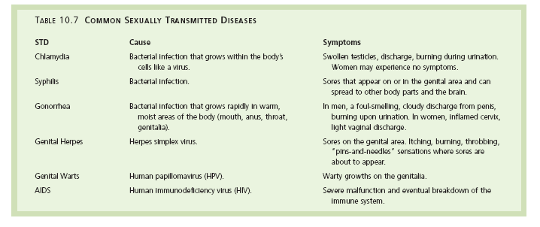
LO 10.16 Sexually transmitted diseases
Menu

Slide 38
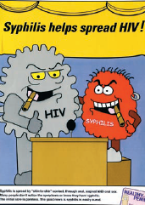
How to Protect Spread of STDs
LO 10.17 Protect against and prevent STDs
Using condoms
Having only one partner
Abstaining from sex
Avoiding IV drug use
Knowing the symptoms of the various diseases
Getting regular physicals
Menu

Slide 39
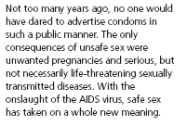

LO 10.17 Protect against and prevent STDs
Menu

